Slide 1

Econometric Property Information Coding
Troy Bailey, Seth Bitney, Kat Pin, Valerie Wilmot, & Yuta Yamaguchi

Slide 2
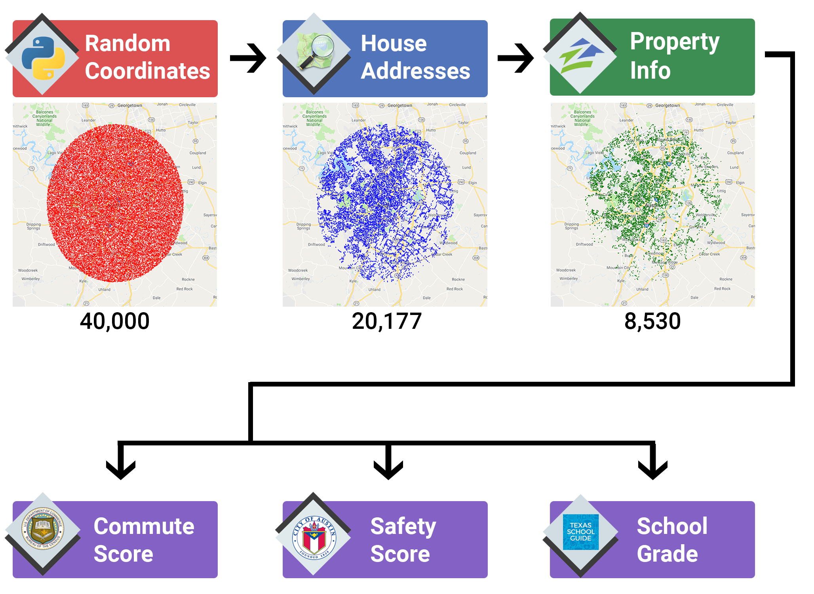
Data Gathering
& Cleanup
Notes:
- Defined city center as Texas State Capital building
- Set radius of 20 miles
Generated 40,000 random geocoordinates
modules used:
random
Math
output to: randomLatLon.csv
- Used randomLatLon.csv
- Queried GeoPy Nominatim API for residential addresses
Cleaned data for further analysis
modules used:
geopy
Time
output to:
addressList.csv
- Used addressList.csv
- Queried Zillow API using PyZillow module for valuation and sqft
- Cleaned data for further analysis
modules used:
pyzillow
GetDeepSearchResults
output to:
masterData.csv

Slide 3

Project 2: Austin Real Estate Explorer

Slide 4

Technologies
Leaflet
D3
Heroku
Flask
GeoPandas

Slide 5
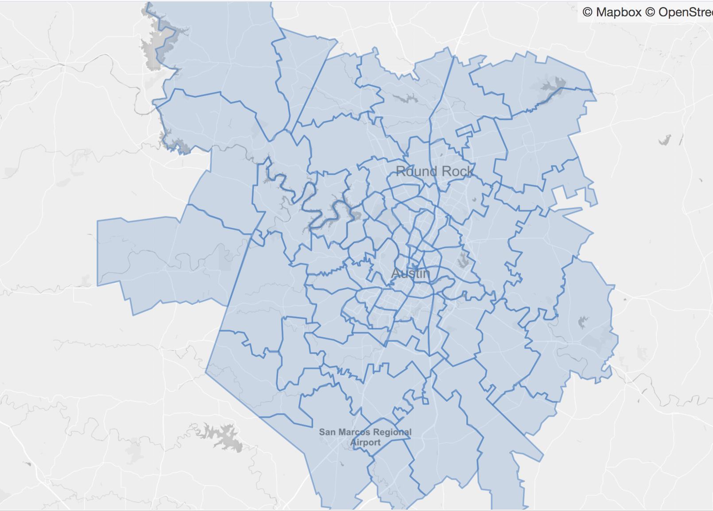
Austin by Zipcode

Slide 6
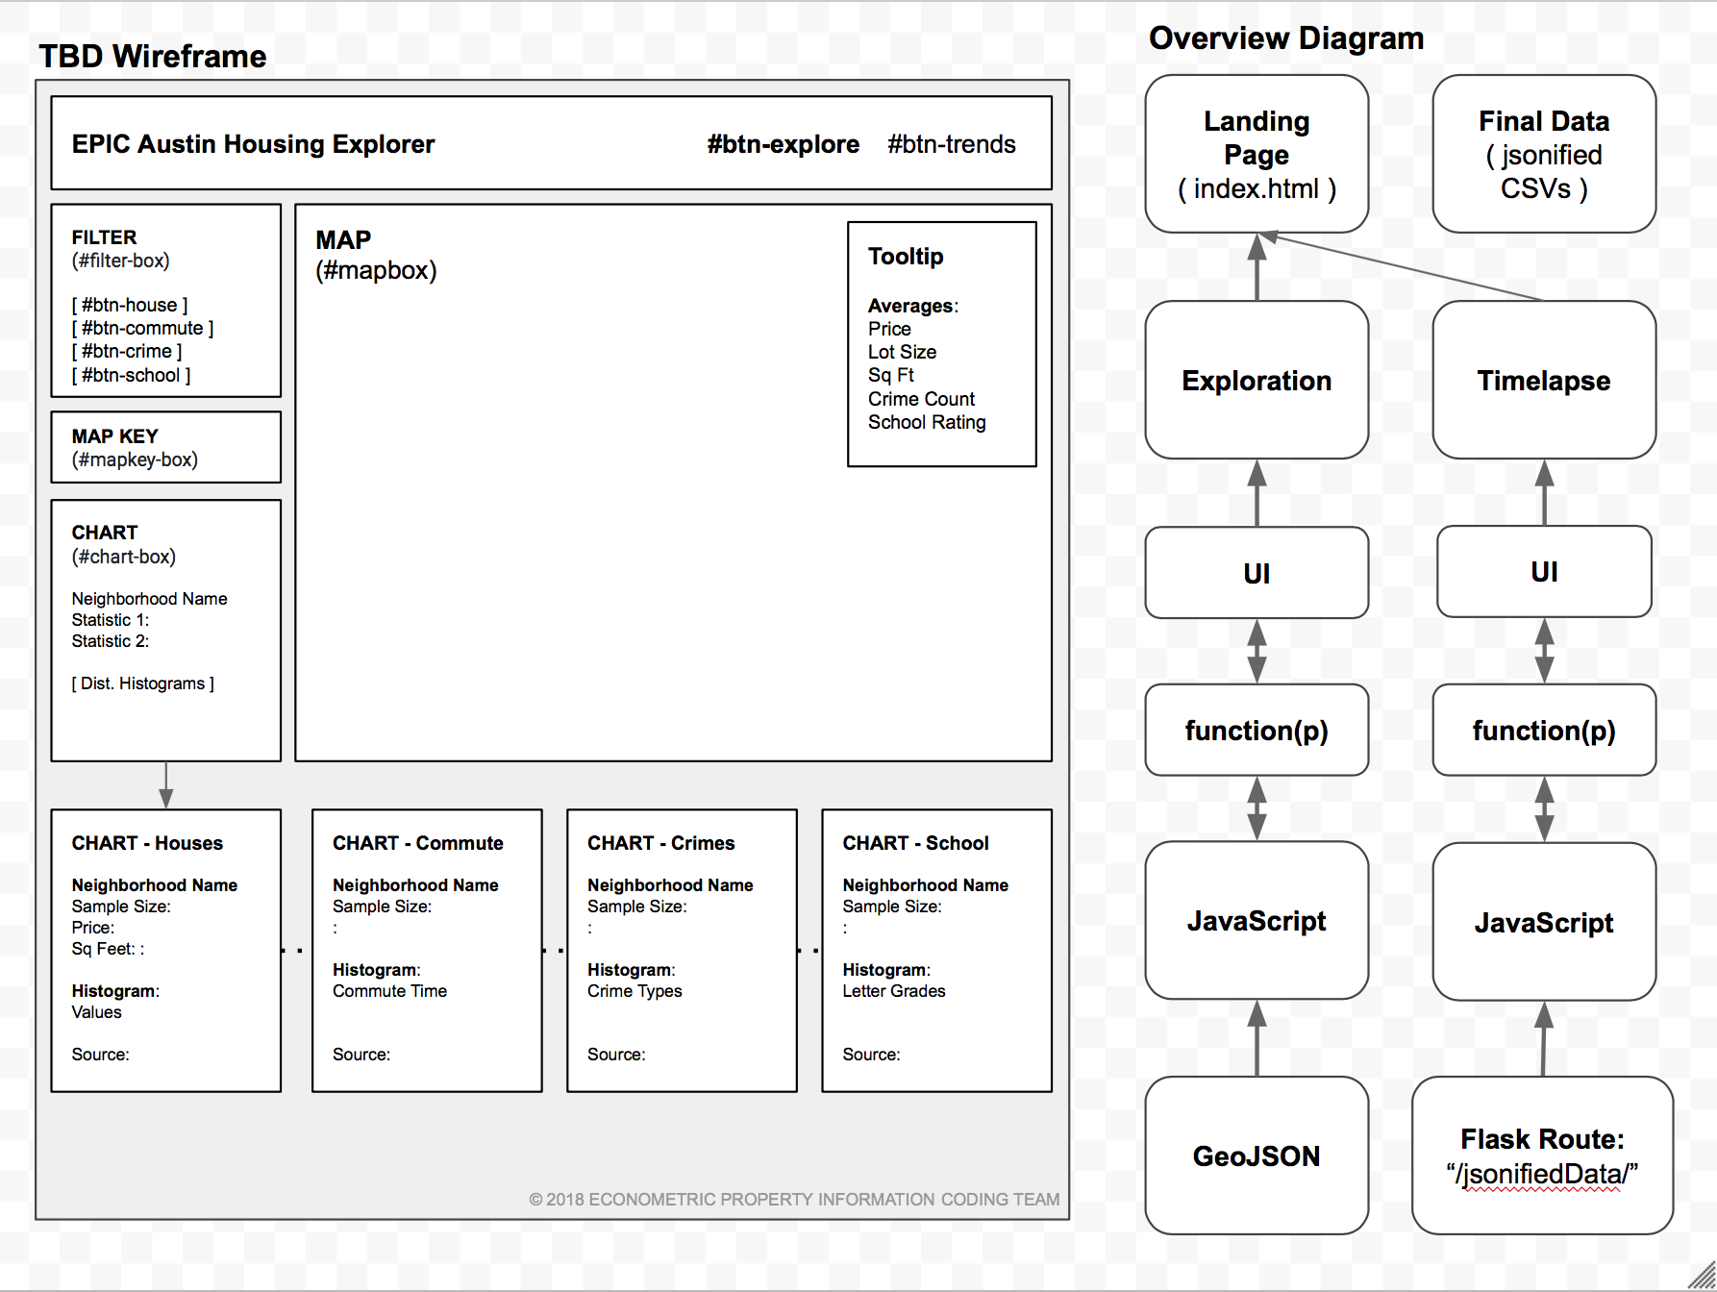
Visualizing Dashboard

Slide 7
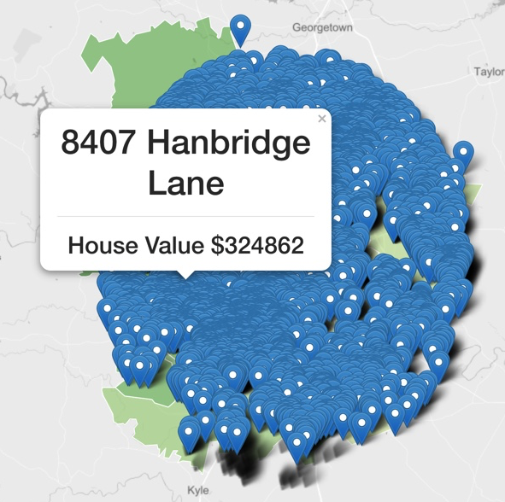
Visualizing Data

